Slide 1
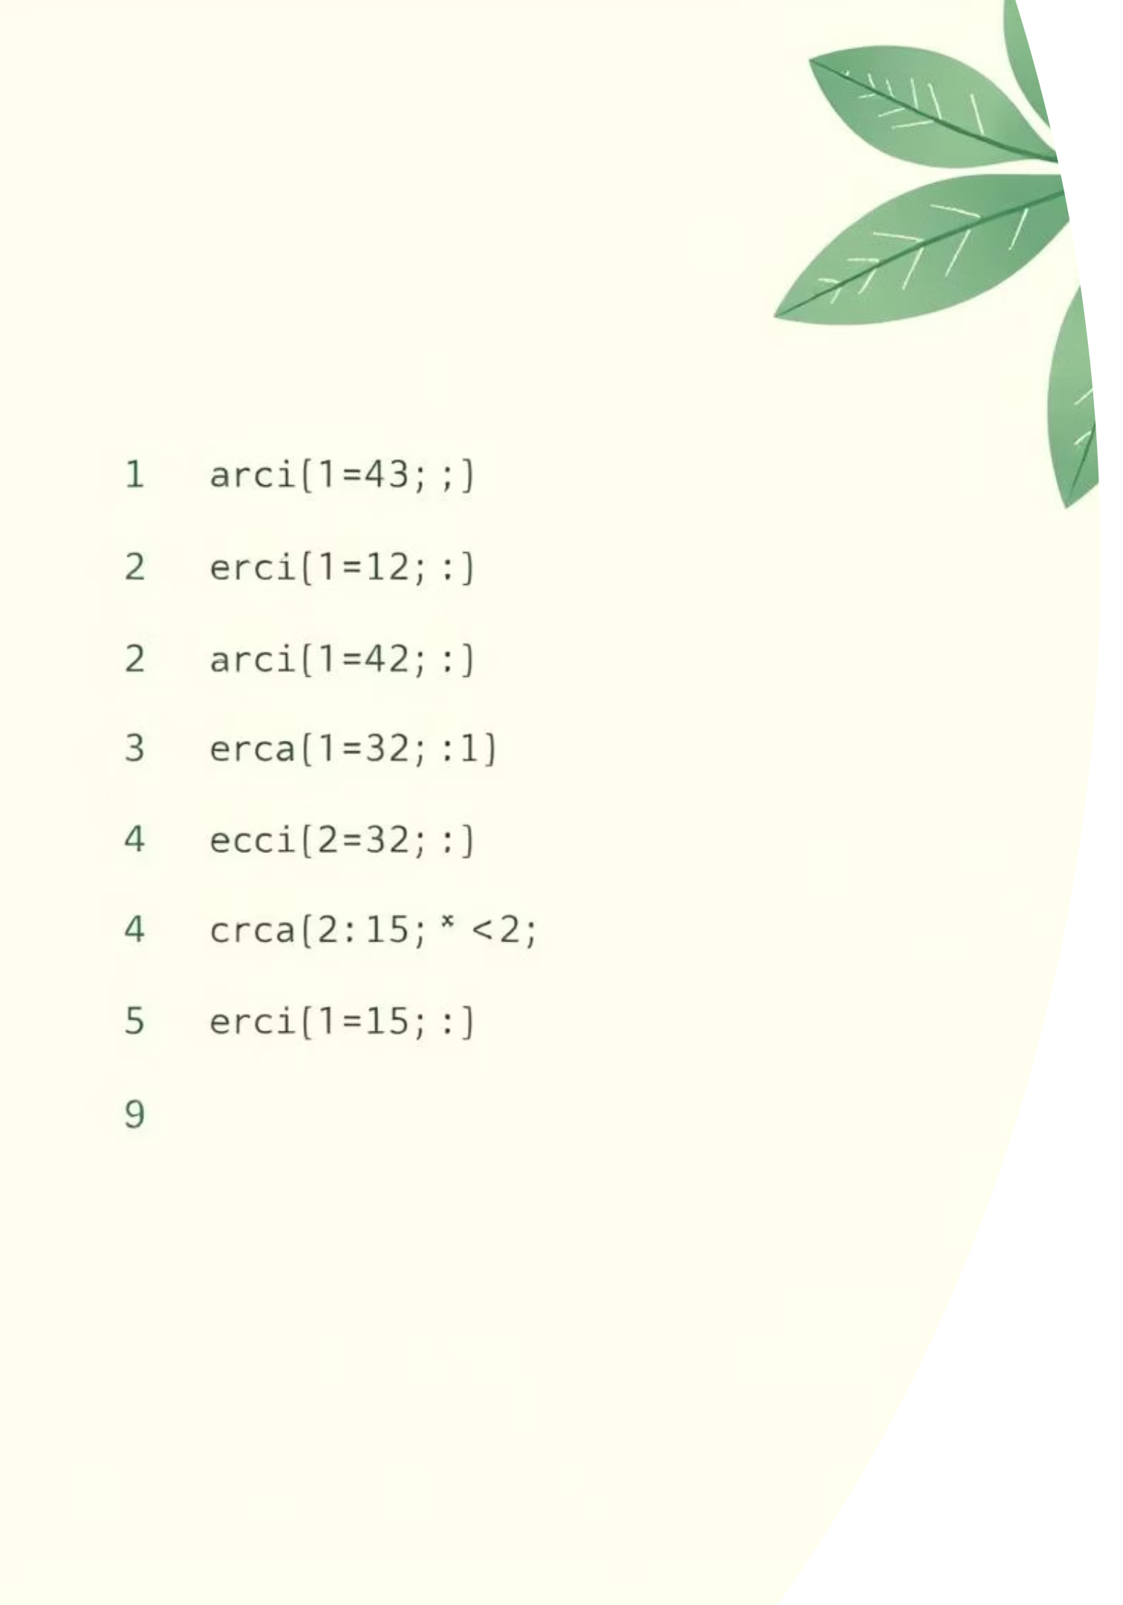
RE → NFA → DFA → Min-DFA Simulator
An interactive tool for visualising regular expressions and finite automata.
Course: Theory of Automata / Theory of Computation
Authors: Sharaiz Ahmed & Ahmed Raza

Slide 2
Understanding Our Regular Expression
Our simulator processes a fixed regular expression, breaking it down into its fundamental components for analysis.
(g+gg+ggg)*mm+hg+ggh
The alphabet for our regular expression is Σ={g,h,m}.
Branch A: (g|gg|ggg)*mm
Branch B: hg
Branch C: ggh
A simple sequence accepting exactly 'hg'.
A simple sequence accepting exactly 'ggh'.
This branch accepts any sequence of 'g's (one, two, or three) repeated any number of times, followed by 'mm'.
Example Accepted Strings: mm, gmm, ggmm, hg, ggh, gggmm.

Slide 3



NFA Design for the Regular Expression
A Non-deterministic Finite Automaton (NFA) is a finite state machine that allows for multiple possible transitions from a given state on the same input symbol, or even without any input (ε-moves).
NFAs are particularly convenient for directly constructing automata from regular expressions due to their flexibility in handling alternatives and repetitions.
Our NFA is constructed with three parallel branches, mirroring the 'OR' structure of the regular expression:
Branch A: (g|gg|ggg)*mm
Key NFA States: q0, q1, q6, q7. This branch handles repetitions of 'g's before two 'm's.
Branch B: hg
Key NFA States: q10, q11, q12. A direct path for the sequence 'hg'.
Branch C: ggh
Key NFA States: q20, q21, q22, q23. A direct path for the sequence 'ggh'.
The application visually demonstrates transitions on input symbols g, h, and m, including epsilon (ε) moves.

Slide 4

NFA Transition Table in the Application
The simulator provides a detailed, formatted NFA transition table, making complex state changes easy to follow.
-> q0
q1
NONE
q6
NONE
q10
NONE
q11
NONE
NONE
q20
q21
NONE
NONE
+ q7
NONE
NONE
NONE
The table highlights start states (q0, q10, q20, reached via a common initial node) and accept states (q7, q12, q23).
The 'e-moves' column indicates transitions without consuming an input symbol, crucial for NFA functionality.

Slide 5

From NFA to DFA: The Subset Construction
A Deterministic Finite Automaton (DFA) is a finite state machine where for each state and input symbol, there is exactly one next state.
The subset construction algorithm systematically converts an NFA into an equivalent DFA, eliminating non-determinism.
Each state in the resulting DFA corresponds to a unique set of NFA states.
DFA State Mapping
Initial DFA State
Each DFA state is a collection of NFA states reachable via ε-closures and input transitions.
The start DFA state, D0, is the ε-closure of all NFA start states: D0 = {q0, q10, q20}.
The application computes and displays the full DFA transition table, including any necessary DEAD/trap states.

Slide 6
DFA Transition Table & Behaviour
The DFA transition table clearly outlines the behaviour of the automaton, with each entry defining a deterministic move.
-> D0
{q0,q10,q20}
D1
D2
D3
D2
{q11}
D5
DEAD
DEAD
+ D5
{q12}
DEAD
DEAD
DEAD
DEAD
NONE
DEAD
DEAD
DEAD
The DFA states are named (e.g., D0, D1) and correspond to their underlying NFA state sets. The DEAD state captures all invalid or stuck transitions, ensuring determinism.
A DFA state is considered accepting if its corresponding set of NFA states includes any of the NFA's accept states (q7, q12, or q23).

Slide 7
DFA Minimisation Concept
DFA minimisation aims to reduce the number of states in a DFA while preserving the language it accepts, resulting in a simpler and more efficient machine.
01
02
03
Partitioning States
Table-Filling Algorithm
Merging Equivalent States
Initially, states are divided into two groups: accepting states and non-accepting states.
Pairs of states are systematically marked as distinguishable if they behave differently on any input symbol, or if one is accepting and the other is not.
Unmarked (equivalent) states are then merged into a single new state in the minimized DFA.
In our project, several accepting DFA states (like D5, D6, D7) are found to be equivalent and are merged into a single, unified accepting state, M5, in the minimized DFA.

Slide 8
Minimized DFA & String Simulation
The minimized DFA, with states such as M0-M5 and a DEAD state, provides the most compact representation of our regular expression.
Simulating 'gmm' on the Minimized DFA:
0
-> M0
-
M0
1
M0
g
M1
2
M1
m
M3
3
M3
m
M5
The app simulates string acceptance by starting at M0 and transitioning based on each input symbol. If the process reaches the DEAD state, the string is rejected. If it concludes in the accept state M5, the string is accepted.

Slide 9


Application Architecture & Technologies
Our simulator is built on robust technologies, providing a clear and interactive user experience.
Java & Swing GUI
Graphviz dot
The core application is developed in Java, leveraging the Swing toolkit for its graphical user interface.
Automata diagrams (NFA, DFA, Min-DFA) are generated using Graphviz's dot command, producing high-quality PNG images from DOT files.
The GUI features an intuitive layout:
Top Panel: Displays the regular expression, input field for test strings, and control buttons (e.g., "Test String", "Show NFA Diagram").
Centre Area: A JTextArea shows transition tables, simulation logs, and other textual output.
Bottom Panel: Provides essential information such as valid symbols and example strings.
Internal data structures utilise Java maps to store transition functions, with methods dedicated to generating DOT code for each automaton type.

Slide 10

Results, Limitations, and Future Work
Our simulator effectively bridges theoretical concepts with practical visualisation.
Demonstrations
The app showcases the entire pipeline: RE → NFA → DFA → Min-DFA construction, followed by string simulation and diagram generation. It's an invaluable tool for visual learning of automata theory.
Current Limitations
Currently restricted to a fixed regular expression and a specific alphabet {g, h, m}.
Requires Graphviz to be installed and correctly configured in the system's PATH.
Future Enhancements
Enable user-defined regular expressions and custom alphabets for broader applicability.
Integrate ε-NFA support and introduce more advanced visualisation options.
Implement functionality to export generated diagrams and simulation results directly for reporting purposes.

